Slide 1
Real Estate Market Analysis Sydney & Melbourne
STAT 31631
Statistical Modelling Project
Group No: 11

Slide 2
Group Members
PS/2020/002 – A.S.N. Perera
PS/2020/202 - M.A.S.C. Siriwardhana
PS/2020/096 – D.A.G. Ranthilina
PS/2020/155 - G.K.M. Pathum
PS/2020/249 - R.H.R.S. Nishshanka
PS/2020/074 - N.C.R. Gunarathna
PS/2020/153 - D.M.S. Indrashan
PS/2020/156 - C.K. Kariyawasam
PS/2020/134 – M.R.R.C. Gunarathne

Slide 3
Introduction
Sydney and Melbourne have vibrant real estate markets, attracting both local and international investors.
Understanding the factors influencing property prices is crucial for informed investment decisions.
Real estate prices are influenced by economic conditions, social trends, and property-specific attributes.
This study uses regression analysis to explore how variables like property size, condition, location, and market trends affect prices.
Beyond financial insights, this analysis can support urban planning, housing policy, and sustainable development. It also contributes to future research in real estate economics.

Slide 4
Problem Statement
Volatility & Complexity: Sydney and Melbourne real estate markets are volatile and influenced by numerous economic, social, and property-specific factors.
Challenges
Lack of Predictive Insight: Current models often fail to predict property prices accurately due to the complexity of influencing variables.
Uncertainty in Decision-Making: Without clear insights into property price drivers, stakeholders risk making suboptimal investment and planning decisions.
Need: A comprehensive regression analysis is necessary to integrate key variables and provide reliable predictions, supporting better decision-making for investors, policymakers, and planners

Slide 5
Significance of the Study
Economic Impact: Understanding property price fluctuations can guide investment and policy decisions, promoting economic stability and growth.
Investment Strategies: Insights into price determinants help investors, both individual and institutional, optimize portfolios, reduce risks, and maximize returns.
Urban Planning & Policy Development: Findings support city planners in making data-driven decisions on infrastructure, zoning, and housing policies for sustainable urban growth.
Social & Environmental Considerations: Analysis of factors like property condition and environmental amenities fosters a holistic approach to real estate, benefiting social equity and environmental sustainability.
Broad Influence: This study informs stakeholders across sectors—economics, investment, urban planning, and social policy—by revealing critical drivers of property prices in Sydney and Melbourne.

Slide 6
Objectives
Identify Key Factors: Determine the most significant variables affecting property prices in Sydney and Melbourne.
Predict Property Prices: Build a regression model to predict property values using these key factors.
Analyze Trends: Examine temporal trends to understand property market fluctuations over time.
Provide Recommendations: Offer actionable insights for investors and policymakers to inform strategic decision-making.

Slide 7
Methodology
Data Collection
Sources: Data from government databases, real estate websites, and market reports.
Variables: Date, Price, Bedrooms, Bathrooms, Sqft Living, Sqft Lot, Floors, Waterfront, View, Condition, Sqft Above, Sqft Basement, Yr Built, Yr Renovated, Street, City, and Statezip.

Slide 8

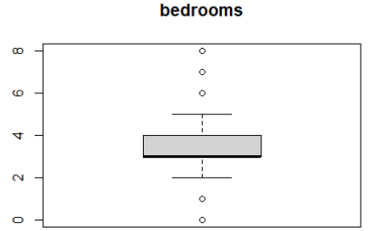
2) Data Cleaning
Address missing values with imputation or removal.
Outliers identified using Z-score and IQR, managed based on impact.
Consistency Checks for accurate formats and ranges.

Slide 9
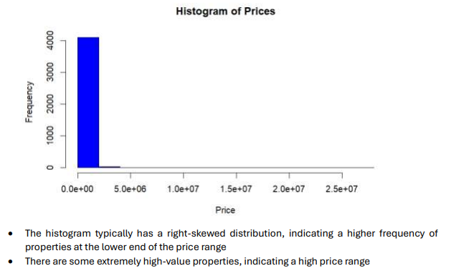
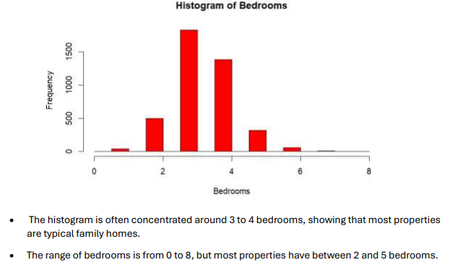
3) Descriptive Analysis
Statistics: Mean, median, standard deviation, etc.
Visualizations: Histograms, scatter plots, and correlation matrices.
Categorical Analysis: Bar charts for variables like Waterfront, Condition

Slide 10
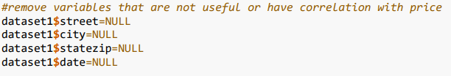
4) Feature Engineering
Derived Features: Property and renovation age.
Categorical Encoding: One-hot or label encoding for variables like City, Statezip.

Slide 11
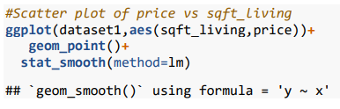
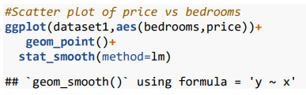
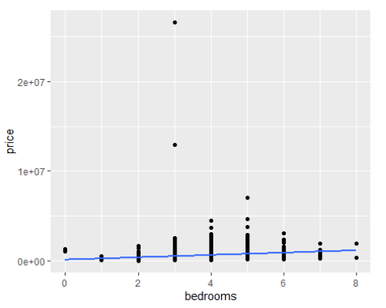
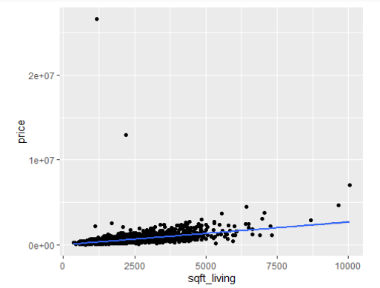
5) Regression Analysis
Model Selection: Linear, Multiple Regression, Lasso, Ridge.

Slide 12
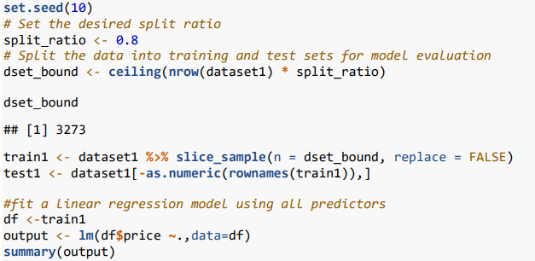
Regression Analysis
Training & Evaluation: R-squared, CP, BIC, MSE to assess model performance.
Residual standard error: 325400, indicating the typical deviation of the observed price from the predicted price.
R-squared: 0.4233, meaning the model explains about 42.33% of the variance in house prices. This indicates a moderate fit, meaning other factors not included in the model could also explain price variations.
Adjusted R-squared: 0.4304, which adjusts the R-squared value for the number of predictors in the model.
F-statistic: 225.8 on 11 and 3261 DF, with a p-value < 2.2e-16, indicating that the overall model is statistically significant.

Slide 13

Regression Analysis
Feature Selection: Backward elimination, forward selection, regularization.
The output suggests that the forward selection process started with an empty model and iteratively added variables that improved the model's fit. The best subset of variables for each model size is presented, allowing you to choose the appropriate number of variables based on your needs (e.g. balancing model complexity and predictive performance)

Slide 14
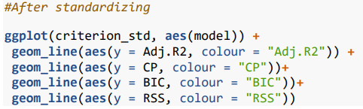
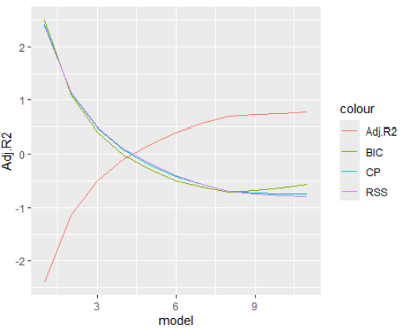

6) Model Validation
Cross-Validation: K-fold to ensure robustness.
Residual Analysis: Check for homoscedasticity and distribution assumptions.
Initial Models (1-3)*: In the early stages, the metrics indicate that simpler models are likely better (lower BIC, higher Adjusted R-squared ).
Mid-range Models (3-6)*: The metrics seem to stabilize, with Adjusted R-squared declining, and BIC increasing, possibly indicating diminishing returns from adding more predictors.
Complex Models (6-9)*: The metrics suggest that more complex models might be overfitting the data (increasing BIC, and possibly decreasing CP).

Slide 15
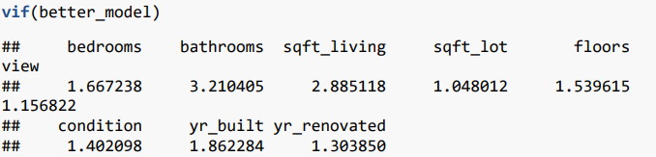
7) Sensitivity Analysis
Scenario Testing: Change variables to observe price impacts.
Elasticity Measurement: Gauge sensitivity of price to key variables.

Slide 16
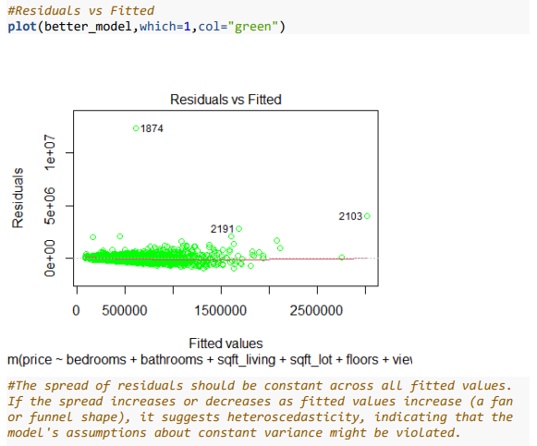
Residuals vs Fitted

Slide 17

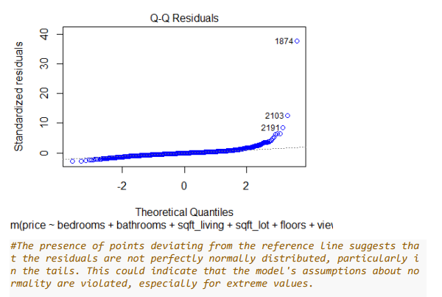
Q-Q Residuals

Slide 18

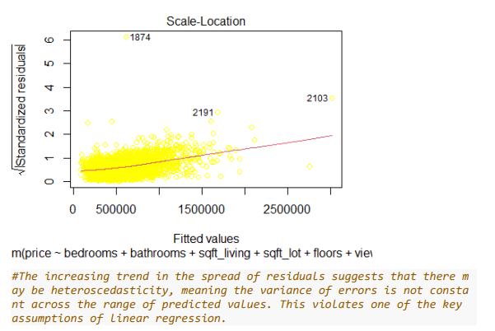
Scale Location

Slide 19
Results and Discussion
Key Predictors: Significant variables include Sqft Living, Bathrooms, Waterfront, and View.
Model Performance: The model explained about 42-43% of the variance in prices, indicating other unmeasured factors at play.
Issues Identified: Presence of heteroscedasticity and non-normal residuals suggests linear regression may not be the ideal model.
Future Directions:
Explore non-linear models or machine learning techniques (e.g., random forests, gradient boosting) for better performance.
Improve by adding more predictors, addressing non-linearity, or incorporating external economic indicators.

Slide 20
Conclusion
Key Findings: Significant predictors include living area size, number of bathrooms, waterfront presence, and view quality.
Model Limitations: With an R-squared of 42-43%, the model only partially explains property price variation, indicating unmeasured factors.
Challenges: Issues such as heteroscedasticity and non-normal residuals suggest that linear regression may not be the best fit.
Future Improvements: More sophisticated models or additional data could enhance predictive accuracy and capture the full complexity of the real estate market.

Slide 21
References
https://www.kaggle.com/datasets
https://github.com/

Slide 22
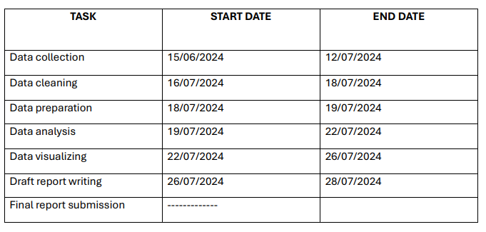
GANTT CHART

Slide 23
Questions and Answers

